Slide 1
5 Days Workshop on " An Overview on Chip Design and Development " DATE: 03-03-2023 to 07-03-2023 Organized By Department of ECE and PDA-ISP CELL in Association with SiyaCon Technologies

Slide 2


Slide 3
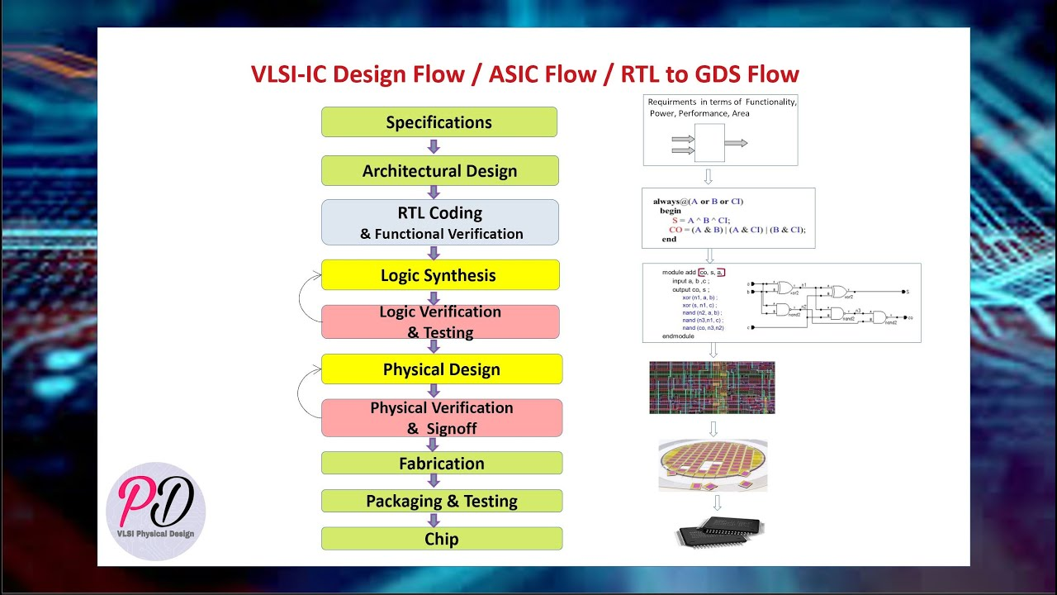

Slide 4
Contents
Introduction to VLSI
VLSI Domain
Semiconductor Industry
Evolution of Semiconductor
About SiliconChip Technologies
Why SiliconChip Technologies
Career Growth
Placement Details
Contact details

Slide 5
Introduction
Introduction to VLSI: This session will introduce the basic concepts and terminology used in VLSI, including integrated circuits (ICs), transistors, gates, and logic circuits.
VLSI Design Flow: This session will cover the various stages involved in VLSI design flow, such as design specification, RTL design, verification, synthesis, layout design, and testing.
Digital Logic Design: This session will cover the basics of digital logic design, including Boolean algebra, logic gates, and combinational and sequential logic circuits.
CMOS Technology: This session will cover the basic principles of CMOS (Complementary Metal-Oxide-Semiconductor) technology, which is widely used in VLSI circuits.
Circuit Design with CMOS: This session will cover the design of various digital circuits using CMOS technology, such as inverters, NAND and NOR gates, flip-flops, and shift registers.
Verification and Testing: This session will cover the verification and testing of VLSI circuits, including simulation, formal verification, and testing methodologies.
Future Trends in VLSI: This session will discuss the latest trends and future directions in VLSI, such as the development of new process technologies, the emergence of new design methodologies, and the integration of emerging technologies such as artificial intelligence and machine learning.
Overall, VLSI technology plays a crucial role in the development of modern electronics, and it continues to be a rapidly evolving field with many exciting opportunities for innovation and growth

Slide 6
VLSI DOMAIN
Reasons why one choose VLSI as their domain:
High demand: VLSI is a highly sought-after domain due to the increasing demand for electronic devices and systems that are faster, smaller, and more power-efficient. As a result, there are plenty of job opportunities in the VLSI industry.
Challenging and exciting work: VLSI design involves complex and challenging work that requires a strong understanding of electrical engineering, computer science, and mathematics. This can make it an exciting and rewarding domain for those who enjoy solving technical problems.
Innovation: VLSI is a rapidly evolving field with continuous advancements in technology, creating opportunities for innovation and cutting-edge research.
Good salary prospects: The VLSI industry offers competitive salaries and benefits, making it an attractive domain for those seeking financial stability and growth.
Diverse career paths: VLSI offers a diverse range of career paths, including VLSI design, verification, testing, and manufacturing, as well as research and development roles.
Overall, VLSI is a challenging and rewarding domain with many opportunities for growth, innovation, and career advancement.

Slide 7
Semiconductor Industry
The semiconductor industry is a sector that produces electronic components made from semiconductor materials such as silicon, germanium, and gallium arsenide.
Here are some important facts and information about the semiconductor industry:
What are semiconductors? Semiconductors are materials that have electrical conductivity between that of a conductor (such as copper) and an insulator (such as rubber). Silicon is the most commonly used semiconductor material.
Importance of semiconductors: Semiconductors are used to make electronic devices such as microprocessors, memory chips, and sensors. These devices are essential components of many modern technologies, including smartphones, computers, and cars.
Market Size: The global semiconductor industry is a multi-billion dollar market, with revenue estimated to be over $500 billion in 2021. The industry is expected to grow at a CAGR of around 6% from 2021 to 2026.
Major Players: Some of the largest semiconductor companies in the world include Intel, Samsung, TSMC, Qualcomm, and Broadcom. There are also many smaller players in the industry, particularly in Asia.
Manufacturing: The manufacturing process for semiconductors is complex and involves several steps, including wafer fabrication, assembly, and testing. The industry is heavily dependent on advanced technology and equipment to produce increasingly smaller and more powerful chips.
Innovation: The semiconductor industry is known for its rapid pace of innovation, with new technologies and products being developed on a regular
Applications: Semiconductors are used in a wide range of electronic devices, including computers, smartphones, tablets, televisions, and automobiles. They are also used in industrial equipment, medical devices, and military equipment.
Trends: The semiconductor industry is constantly evolving, with new technologies and trends emerging regularly. Some current trends include the shift to 5G wireless networks, the Internet of Things (IoT), and artificial intelligence (AI).

Slide 8
Evolution of Semiconductor
Technological advancements: The growth of the semiconductor industry has been driven by technological advancements that have allowed for the production of increasingly smaller and more powerful chips. These advancements include improved manufacturing processes, better materials, and the development of new technologies like AI and 5G.
Demand from end-user industries: The semiconductor industry has benefited from strong demand from end-user industries such as consumer electronics, automotive, and industrial equipment. As these industries continue to grow and innovate, the demand for semiconductors is likely to continue to increase.
Emerging markets: The growth of the semiconductor industry has also been driven by emerging markets, particularly in Asia. Countries like China, South Korea, and Taiwan have become major players in the industry, with companies like TSMC and Samsung leading the way.
Investment in R&D: The semiconductor industry is highly competitive, and companies that invest in research and development (R&D) are more likely to succeed. Many companies in the industry invest heavily in R&D to develop new products and technologies that can give them a competitive edge.
Mergers and acquisitions: Mergers and acquisitions have played a role in the growth of the semiconductor industry, with larger companies acquiring smaller companies to gain access to new technologies or expand their market share.
Future growth potential: The semiconductor industry is expected to continue to grow in the coming years, driven by factors such as the increasing adoption of IoT devices, the transition to 5G networks, and the growth of emerging markets. However, there are also challenges facing the industry, including rising manufacturing costs and supply chain disruptions.

Slide 9
Why Our Institute
We are a startup with energetic working professionals having 10+ years of experience who are dedicated to train the students to excel in their careers.
Offline classes with hands-on lab session with VLSI tools.
Assignments & Projects are assigned to students to read the skill development on weekly basis.
1:1 mentoring sessions are held by Industry experts.
Courses provided are budget friendly compared to other training institutes & 100% job determined.
Training process is designed to provide technical & soft skill knowledge to haver a better job understanding.
We have our training institute in Bangalore and Kalaburagi.

Slide 10
About SiliconChip Technologies
SiliconChip Technologies is Known as Best VLSI Training Institute in Bangalore & Kalaburagi offers Industry’s best VLSI training curriculum, covering all aspects of Training program.
Our Training Institute was set up in 2018, offers industry standard, high quality, affordable training to graduates.
Institute is among the very few institute offering quality training in complete spectrum of VLSI flow from RTL design, Functional Verification, Formal Verification, GLS, Synthesis, STA, Physical Design, DFT, Custom Layout and Physical Verification. We also offer courses on AMBA, PCIe, USB, Low power verification and SOC verification, customized for experienced engineers. want to make career in VLSI, and Embedded systems.
100% job oriented VLSI training courses

Slide 11
Career Growth
There is lot of opportunities after completion of VLSI Program. Some of the job opportunities in this domain are Verification Engineer, Design Engineer, Application Engineer, CAD Engineer, etc.
VLSI Design Engineer: VLSI design engineers are responsible for designing and testing complex integrated circuits and systems. They use design software and tools to create and simulate circuits, and work closely with other engineers to ensure that designs meet performance, power, and area requirements.
Verification Engineer: Verification engineers are responsible for ensuring that VLSI designs meet functional and performance specifications. They develop test plans, create and run simulations, and debug designs to identify and resolve issues.
Physical Design Engineer: Physical design engineers are responsible for creating the layout and physical implementation of VLSI designs. They use tools to place and route circuits, optimize power and timing, and ensure that designs meet manufacturing requirements.
Analog/Mixed-Signal Design Engineer: Analog and mixed-signal design engineers are responsible for designing circuits that operate in the analog domain, such as amplifiers, filters, and data converters. They must have a deep understanding of circuit theory and be able to design circuits that meet strict performance requirements.
System on Chip (SoC) Architect: SoC architects are responsible for designing and developing complex systems that integrate multiple functions onto a single chip. They must have a broad understanding of VLSI design, including digital and analog circuits, and be able to optimize system-level performance.

Slide 12
Test Engineer: Test engineers are responsible for developing and implementing test plans and procedures to ensure that VLSI designs meet performance and reliability requirements. They work closely with other engineers to identify and resolve issues, and may also be responsible for developing automated test equipment.
Product Engineer: Product engineers are responsible for managing the lifecycle of VLSI products, from development through production and beyond. They work closely with design, manufacturing, and marketing teams to ensure that products meet customer needs and are cost-effective to produce.
Process Engineer: Process engineers are responsible for developing and optimizing the manufacturing processes used to produce VLSI products. They must have a deep understanding of semiconductor manufacturing technology and be able to identify and address issues that impact yield and quality.
Applications Engineer: Applications engineers work closely with customers to understand their requirements and develop solutions that meet their needs. They must have a deep understanding of VLSI design and be able to communicate technical information effectively to both technical and non-technical audiences.

Slide 13



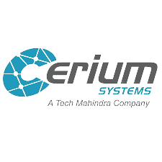








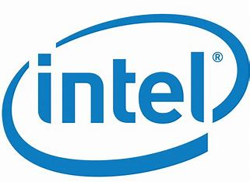


Placements with :

Slide 14




Contact details :
+91 8792662546
training@siliconchip.in
http://www.siliconchip.in\
#25/A, 2nd floor, Next to St. Theresa School, Kamadenu Layout, B. Narayanapura, Bengaluru, Karnataka

Slide 15
THANK YOU

